Slide 1


Proxy Design Pattern

Slide 2
Proxy Design Pattern
Proxy is a structural design pattern that lets you provide a substitute or placeholder for another object. A proxy controls access to the original object, allowing you to perform something either before or after the request gets through to the original object.

Slide 3
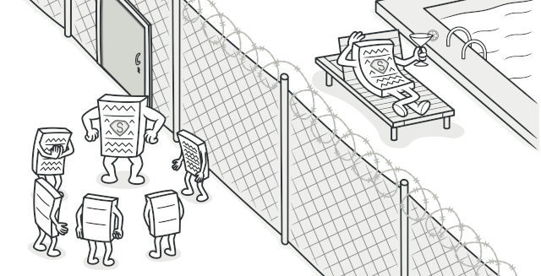

Slide 4
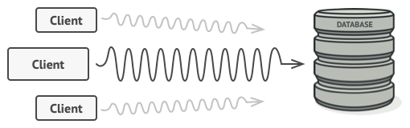
Problem
You need to support resource-hungry objects, and you do not want to instantiate such objects unless and until they are actually requested by the client.

Slide 5
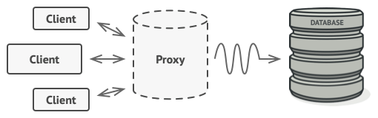
Solution
The Proxy pattern suggests that you create a new proxy class with the same interface as an original service object. Then you update your app so that it passes the proxy object to all of the original object’s clients. Upon receiving a request from a client, the proxy creates a real service object and delegates all the work to it.

Slide 6
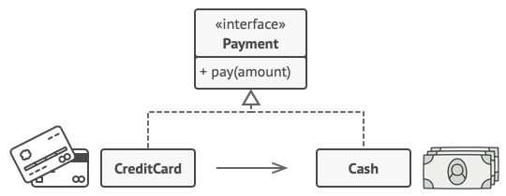
A credit card is a proxy for a bank account, which is a proxy for a bundle of cash. Both implement the same interface: they can be used for making a payment. A consumer feels great because there’s no need to carry loads of cash around. A shop owner is also happy since the income from a transaction gets added electronically to the shop’s bank account without the risk of losing the deposit or getting robbed on the way to the bank.

Slide 7
Demo

Slide 8
References
https://refactoring.guru/design-patterns/proxy
Proxy Pattern – Javatpoint
https://refactoring.guru/design-patterns/proxy

